Slide 1


SMART CITY UNDER IoT TECHNOLOGY
Prepared by: Tanmay Patel
EC Department
19EC056
Guided by: Prof. Miral Desai
Assistant Professor
EC Department

Slide 2
Project Description
1
Content
Hardware Components
2
Basic Information
3
Proposed System Block Diagram
4
Program Flow Chart
5
Experimental Set-up
6
Application
7

Slide 3


Technology is just a tool. In terms of getting the kids working together and motivating them, the teacher is the most important.
-Bill Gates

Slide 4
Project Description
This project is smart city project which is based on IoT Technology
In this system we make a smart manual operating street light which is used to perform task as per the weather needed and as per the developer need.

Slide 5
Hardware Components
ESP32 DOIT DEVKIT V1 MODULE (30 PINS)
IR Sensor
LDR Sensor
LEDs

Slide 6
IoT Technology
The term "Internet of things" (IoT) refers to physical objects (or groups of such objects) equipped with sensors, computing power, software, and other technologies that communicate with one another and exchange data through the Internet or other communications networks.
The basic idea of a network of smart devices was originally proposed in 1982

Slide 7
Blynk
Blynk is an IoT company which provides a platform for building mobile applications that can connect electronic devices to the Internet and remotely monitor and control these devices.
Blynk was founded by Pavel Bayborodin, who is a user experience (UX) expert in mobile and automotive space.
The IoT platform was launched in 2014.

Slide 8
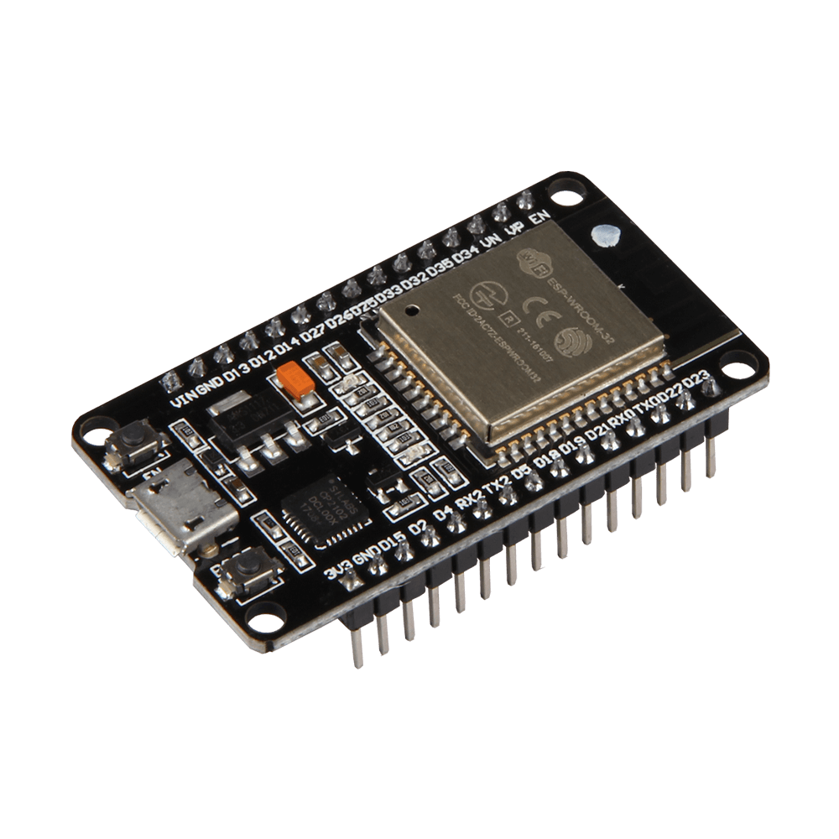
ESP32
ESP32 is a series of low-cost, low-power system on chip microcontrollers with integrated Wi-Fi and dual-mode Bluetooth.
ESP32 is created and developed by Espressif Systems.

Slide 9
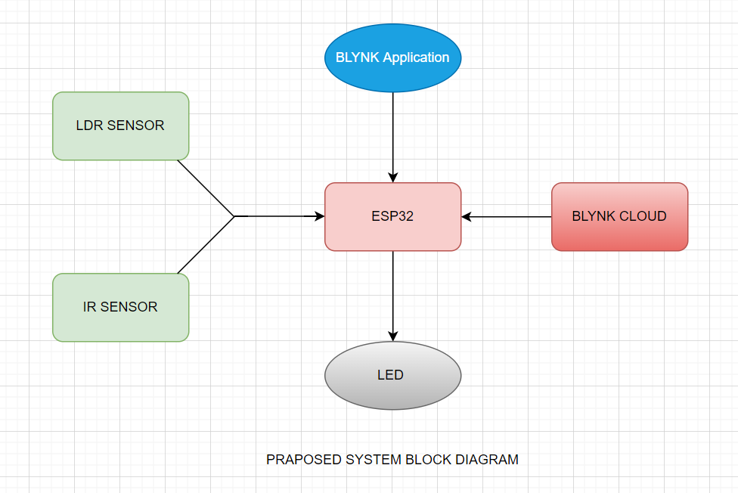
Proposed System Block Diagram

Slide 10
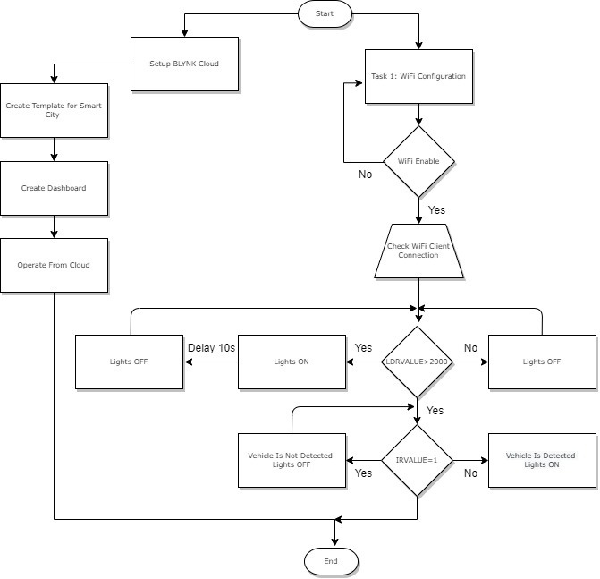
Program Flow Chart

Slide 11
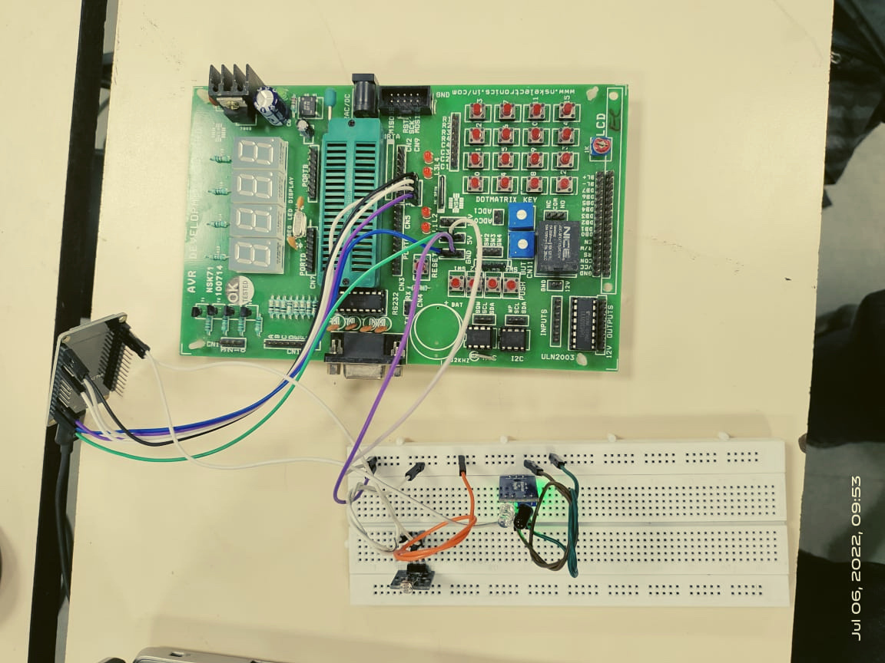


LED'S
Experimental Set-up
Esp32 Bord
IR Sensor
LDR Sensor

Slide 12
Application
It is used in smart city.
It could act as a hub for smart applications.
Smart Street lights could be equipped with Radar Sensors which could detect if any object comes near the pole and the light gets brighter.
It is also used for digital signage.

Slide 13


